Slide 1
Sustainable, Just & Productive
Water Resources Development In Western Nepal
Under Current & Future Conditions
(DIGO JAL BIKAS – DJB)
Exploring sustainable farming opportunities:
A case of a marginal female farmer from Kailali
Emma Karki, Sanita Dhaubanjar
USAID GESI Summit
Kathmandu, Nepal
2nd October, 2018

Slide 2
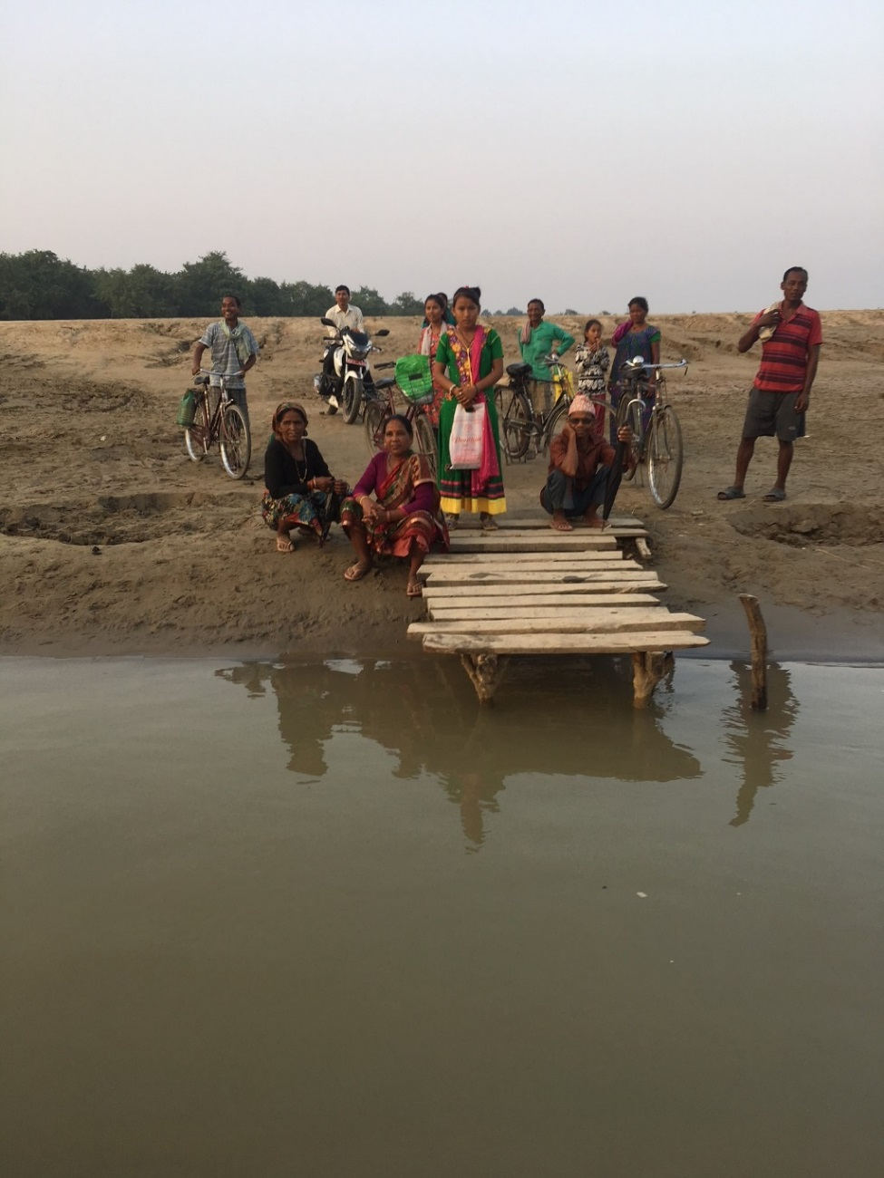
DJB Pilot Interventions
GOAL: Improve livelihoods of marginal communities by increasing water use productivity
Seasonal water availability
Unequal water access and inefficient utilization
Diverse land ownership limits available resource usage
3 pilot sites:
Kuti village in Terai, Kailali
Punebata and Mellekh village in the hills in Doti
Notes:
- villages face water access issues during the dry months while Kuti faces greater issue of floods in the monsoon as well.
Land ownership is diverse, Kuti has the highest number of households renting land. Farmers also have to rent equipment, pump sets, fuel etc.
with the intention of helping farmers come together to pool and share resources for better livelihood outcomes, especially through enhanced water use productivity

Slide 3
The Case of Chuliya Chaudhary, 73, Kuti, Kailali
Oldest member in the farming group
Wage labourer supporting 11 family members
Widow. Lost her husband 22 years ago
Subsistence farming in unregistered land
From a marginal community with unequal access to water
Reliance on male farmers for technical farm work
Notes:
Chuliya is just an example of farmers caught in the vicious cycle of multiple marginalization
Member of the Lakhrai Vegetable Farming Group in Kuti village, comprising 16 women and men. Her group is one of 5 farmer groups established across 3 villages as part of the project

Slide 4
Key Drivers for GESI integration
Lack of women’s participation
Lack technical know-how
Limited role in pump rental negotiation
High rate of male migration putting pressure on women
Social inhibition
Male domination
Conventional agriculture is physically intensive
More power in decision making
Limited access and agency of marginal communities
Mostly landless or tenant farmer
Large gap in irrigation pump/pond ownership
Unequal access to water infrastructure
Live in areas with low crop productivity
Only rain-fed and subsistence agriculture
Notes:
We realized that GESI integration is key to the success of our interventions
Water access and use if affected by existing gender and power dynamics
The focus is on women but also marginalized communities. Groups include men and women.
There is multiple marginalization
We recognize that women face additional burden and our interventions shouldn’t add to that burden
We need male farmers to participate and know about the work being done in their village.
Allows for women and men to come together to discuss issues faced as farmers identify issues that women face that men way be unaware completely.

Slide 5
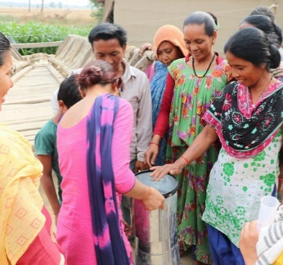
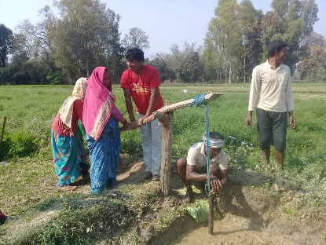
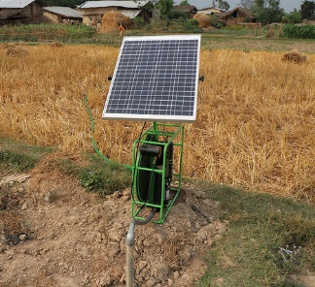
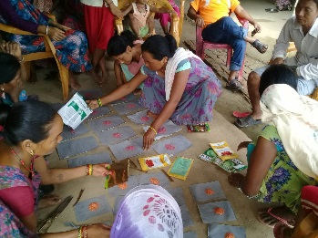
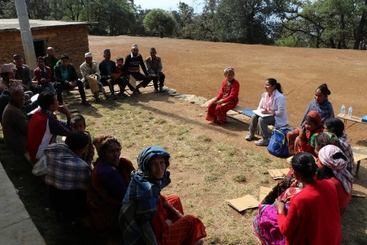
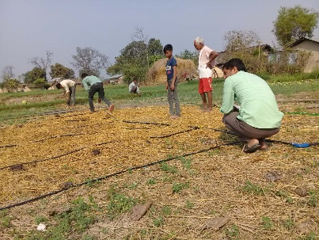
Establishment of collectives for tenant farmers to take joint lease
Introduction of gender friendly technology
Sharing of irrigation resources, labour and farm inputs
Training on vegetable farming
Seed Distribution
Enhance Market Linkages
Voluntary consolidation of land
Collective Farming:
A Techno-Social Approach
Notes:
Collective farming approach for GESI integration from planning to implementation
Successful integration of gender in ACIAR project in Saptari
our interventions shouldn’t add to womens burden
Establish collectives and land pools:
Interest to join the groups from the communities was key. All hamlets are consulted via a problem tree analysis.
Farmers group selected based on interest and the physical feasibility of the community. Eg: water source, ability and desire to lease land (important component of collective farming approach)
5 farmer groups established: 63 farmers, 34 women (35% women)
Female farmer friendly technology:
Technologies
Micro-irrigation (drip and sprinkler): climate smart technology. Move away from the notion that fields need to be flooded to increase productivity.
Solar pumps for groundwater pumping – gender friendly technology
can be moved around and is viewed as a less male dominated technology by the farmers (reflections from ACIAR project).
Rehabilitation of ponds for irrigation
Ridge and furrow irrigation
Resource sharing: (Irrigation infrastructure, input, labour)
Capacity building:
Allow men and women to learn new technology together and help each other as a collective
Farmers have different knowledge and capacities so try to bring them on the same level of understanding
Local field assistant is available for more information since one time training is not enough
Provide seeds to apply the knowledge and use the water technology provided.
Enhance linkage to the market
Long term goal but our initial impact is the inclusion of vegetables in their diet and money saved by such practices

Slide 6
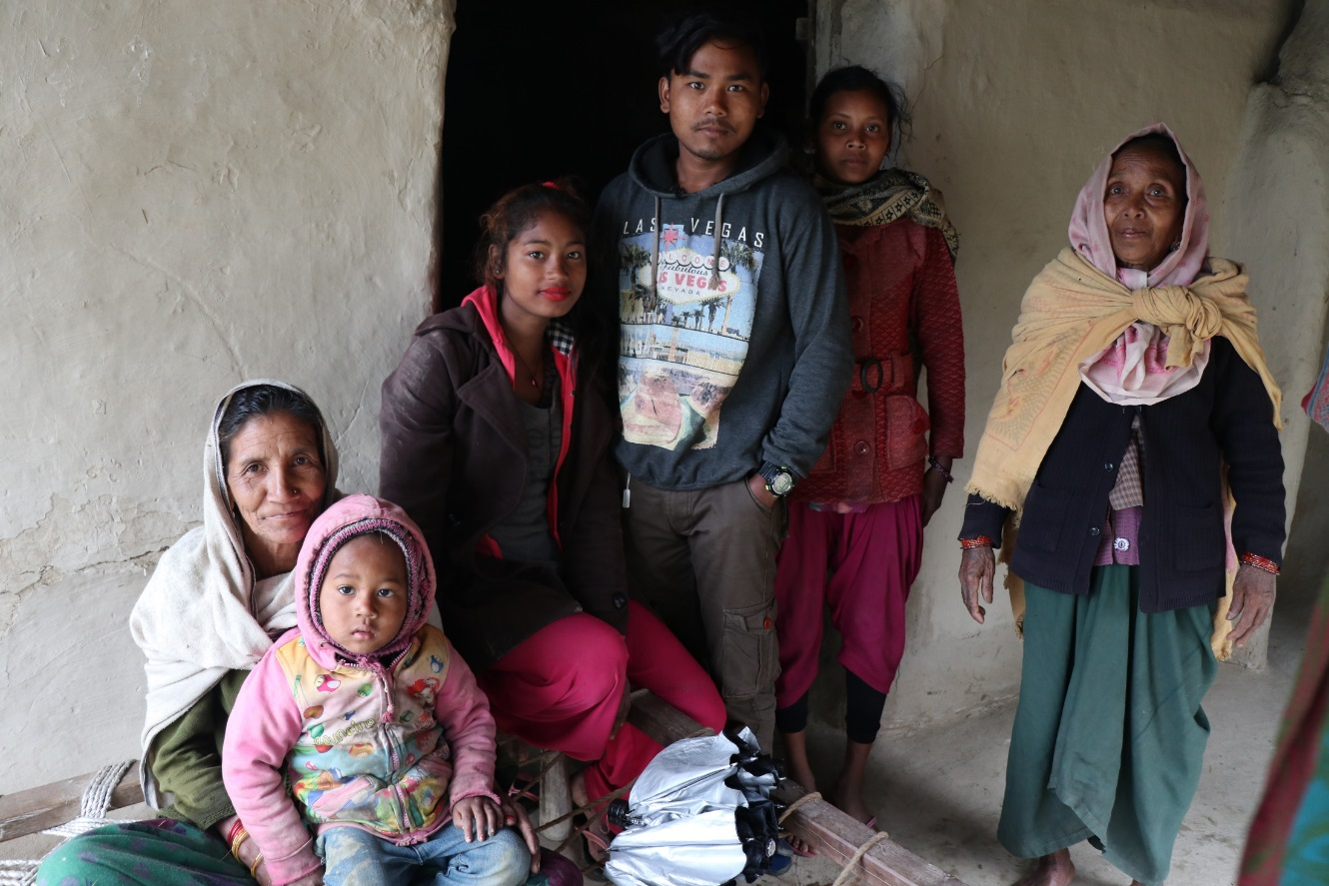
Chuliya’s Successes
“I wasn’t aware that there is a proper technique when it comes to growing different vegetables. At the same time, we didn’t have irrigation facilities and I could only do so much by bringing water from the hand pump to water the vegetables.
Now I have received training, there is a solar pump in our farmers group and most importantly I have the right variety of seeds.”
Enhanced agricultural skills via trainings
Systematically scaled up her kitchen garden
Vegetables are now part of their daily diet

Slide 7
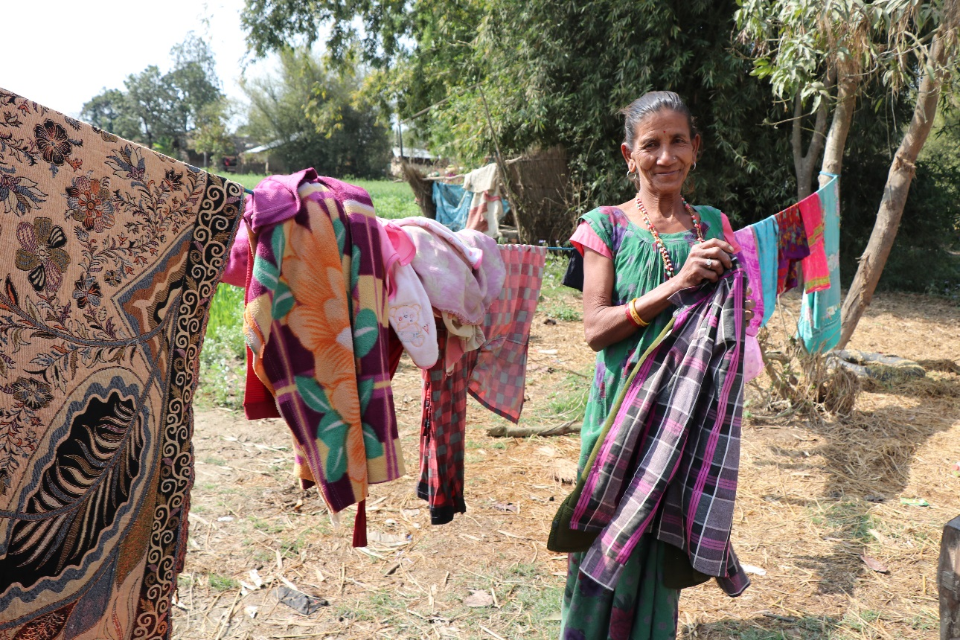
Chuliya’s Successes
Aspires to grow enough to sell surplus
Reduced time required for agriculture through shared labour and resources
Interested in maintaining the partnerships in farmers collective’s
“Since the project began I have managed to save 4000-5000 NPR already. It is my wish to continue growing vegetables and thank the project for this learning opportunity”

Slide 8
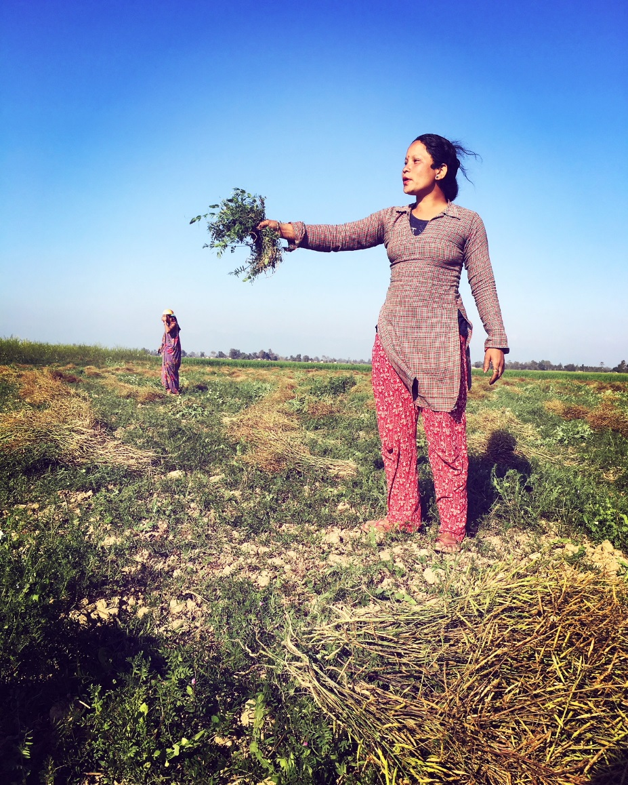
Replication of Approach
Collective action successfully applied in past IWMI projects
Qualitative evidence of success in DJB already observed
Enhancing household nutrition level
Adoption of irrigation technology
Collecting data on farmers’ inputs, investment and returns
Huge scope for up-scaling collective action as a techno-social approach
Empower landless and marginal farmers
Motivate adoption of new technologies
Reduce financial burden for irrigation technology investments
Notes:
Learnings from ACIAR in Nepal, India and Bangladesh to apply similar approach to the Western region and also in hilly regions.
Qualitative evidence:
Initial conversations with farmers have been positive
Many have adopted drip and sprinklers and we hope to influence other farmers save time and resources
This will require more time since it requires a change in behaviour, moving away from traditional practices.
Farmers are including vegetables in their diets which is also an impact to their overall household food security.
Quantitative evidence:
We are collecting plot level data on farmer inputs (time, inputs, labour), seed for each plot.
The forms are filled out by farmers with the help of the LFA to give ownership of that information and discuss amongst the collectives.
We want to inform farmers to make them aware of the resources they are spending and trying to quantify that to inform them of their investment to each plot
We will also calculate money earned/saved by selling vegetables to look at profit/savings made through this process
Important to show farmers their investment and returns to adopt modern technologies and different crops to enhance productivity/provide a source of income.

Slide 9
Challenges Faced
Reluctance of marginalized landless farmers
Costs associated with leasing land a deterrent
Incentives needed for farmers to adopt modern tools
Difficult to maintain interest and motivation of the farmers
Hard to ensure inclusions and representation of all member in collectives
Plots have to be next to each other
There has to be a potential water source – not all households have physically feasible sources
Farmers need to show interest
Notes:
Farmers are reluctant to invest, they expect full support from the project.
Marginalized farmers might not have the time or capital to invest. Working with them and changing their behaviour requires more time and investment.
One way could be to pay their rent for the first year but there is always a risk that once the project ends the community might not continue.
WE focused on interest to target farmers with the hopes that the impact on them would be an incentive for other farmers to join and form their own collectives
Farmers are reluctant to adopt new technologies.
We are using plots to visually illustrate the different irrigation methods and quantify the costs and benefits of using each.
They will be more willing to invest in modern tools and tech once they understand that the extra work brings better returns. Eg farmers don’t want to use drip since it requires filling up buckets and planting based on the pipe water openings. This would mean a shift from their current farming practices.
The use of the data collection form will hopefully quantify the investment to encourage farmers.
Collective farming is based on the idea of sharing resources.
They also needed plots next to each other so that the water can be shared equally. This is the most difficult challenge For eg. two hamlets in Kuti did not want to rent land.
We were limited to selecting farmers with access to a water source nearby, without any conflict.
Requires longer community engagement. 3 year project takes time to select plots, form groups and difficult to measure impact, especially on social and gender change.
This is a long and slow and frustrating process but we want to include the other hamlets in the end of the project by sharing the farmers groups learning and experiences to influence others.

Slide 10
Thank you!
Questions?
Contact: Emma Karki <E.Karki@cgiar.org>

